Slide 1


Slide 2
AIM
To improve the accuracy & speed in restaurants by digitalizing the interaction between customers and restaurants.

Slide 3
objective
To build a cross platform chatbot app for customers and a website for restaurants .

Slide 4
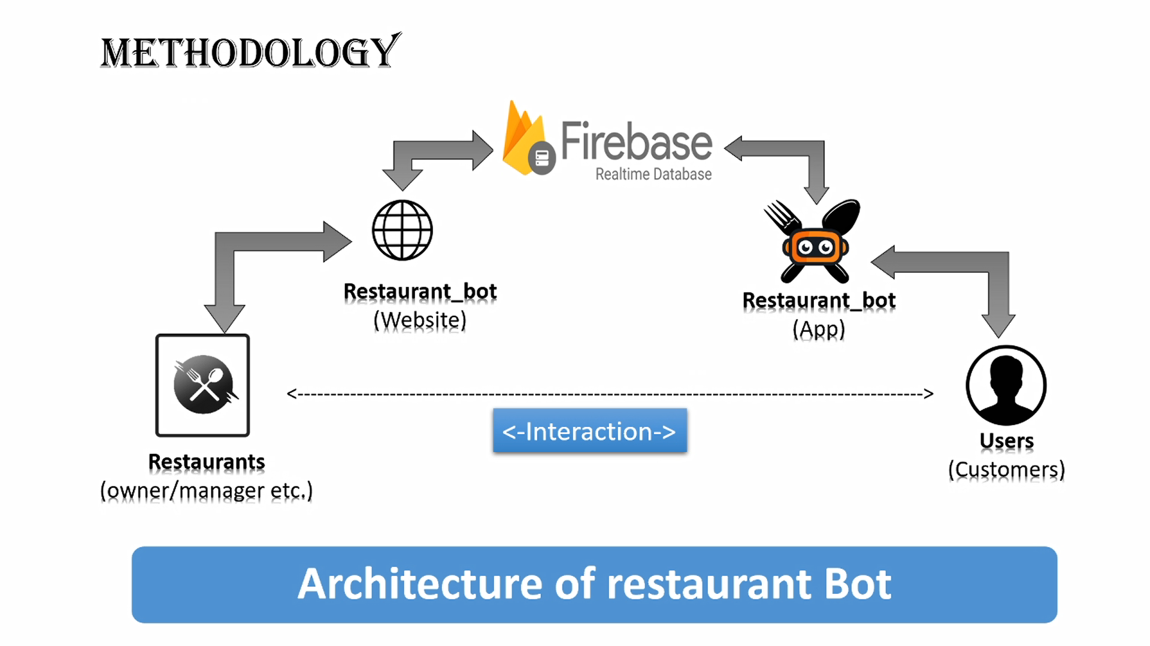

Slide 5
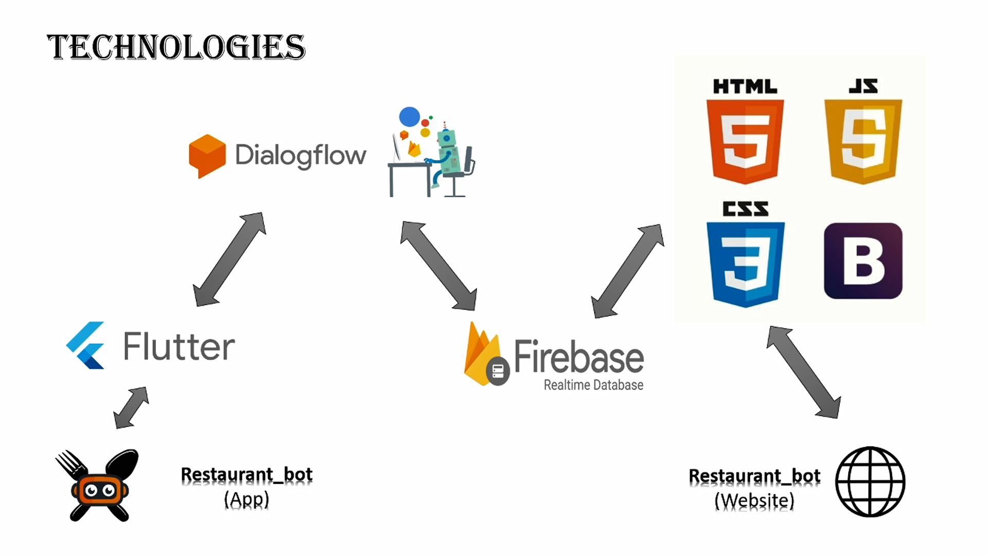

Slide 6
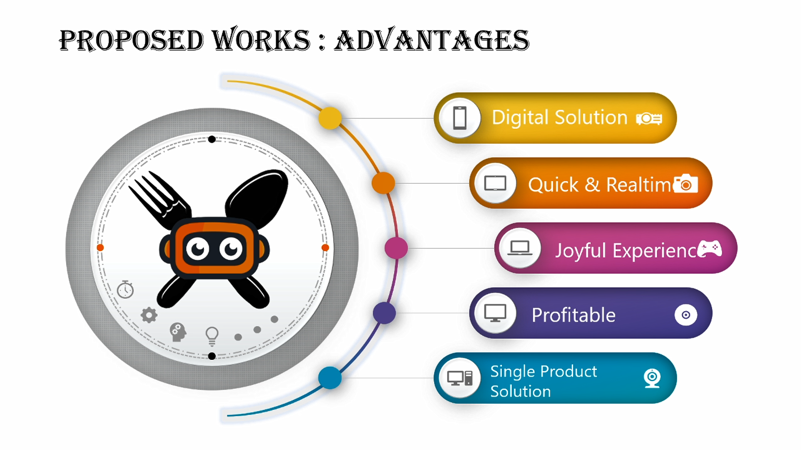

Slide 7



Future scope
Multiple
Language support
Online
Payments
Digital
Receipts

Slide 8
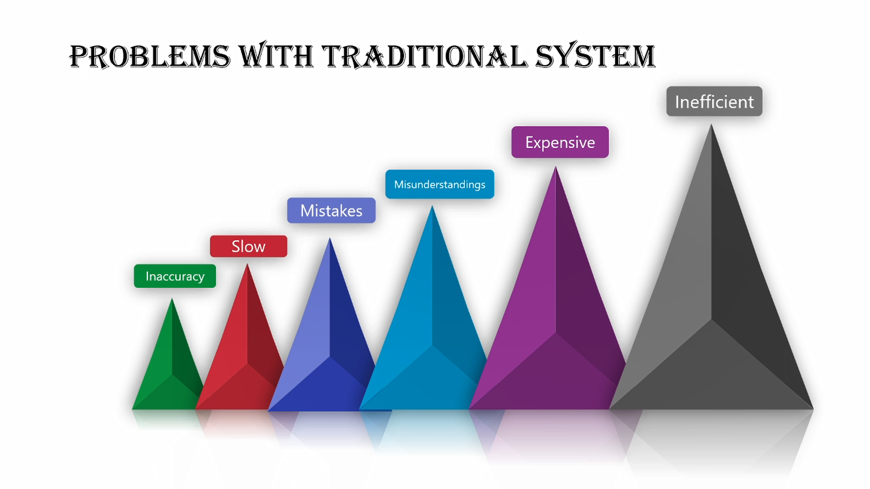

Slide 9
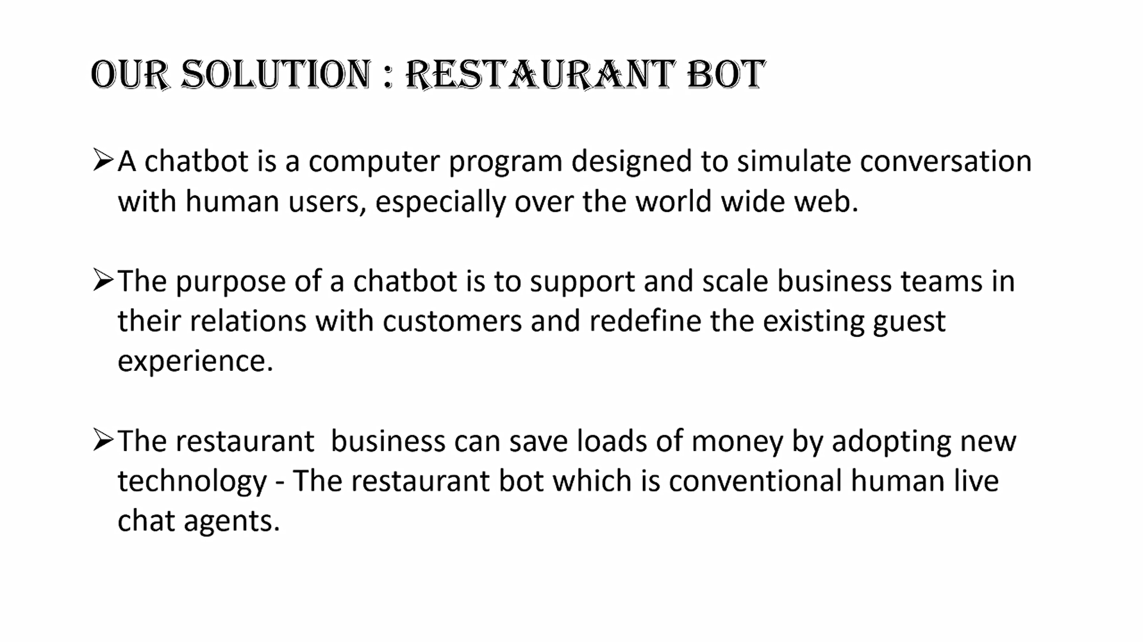

Slide 10
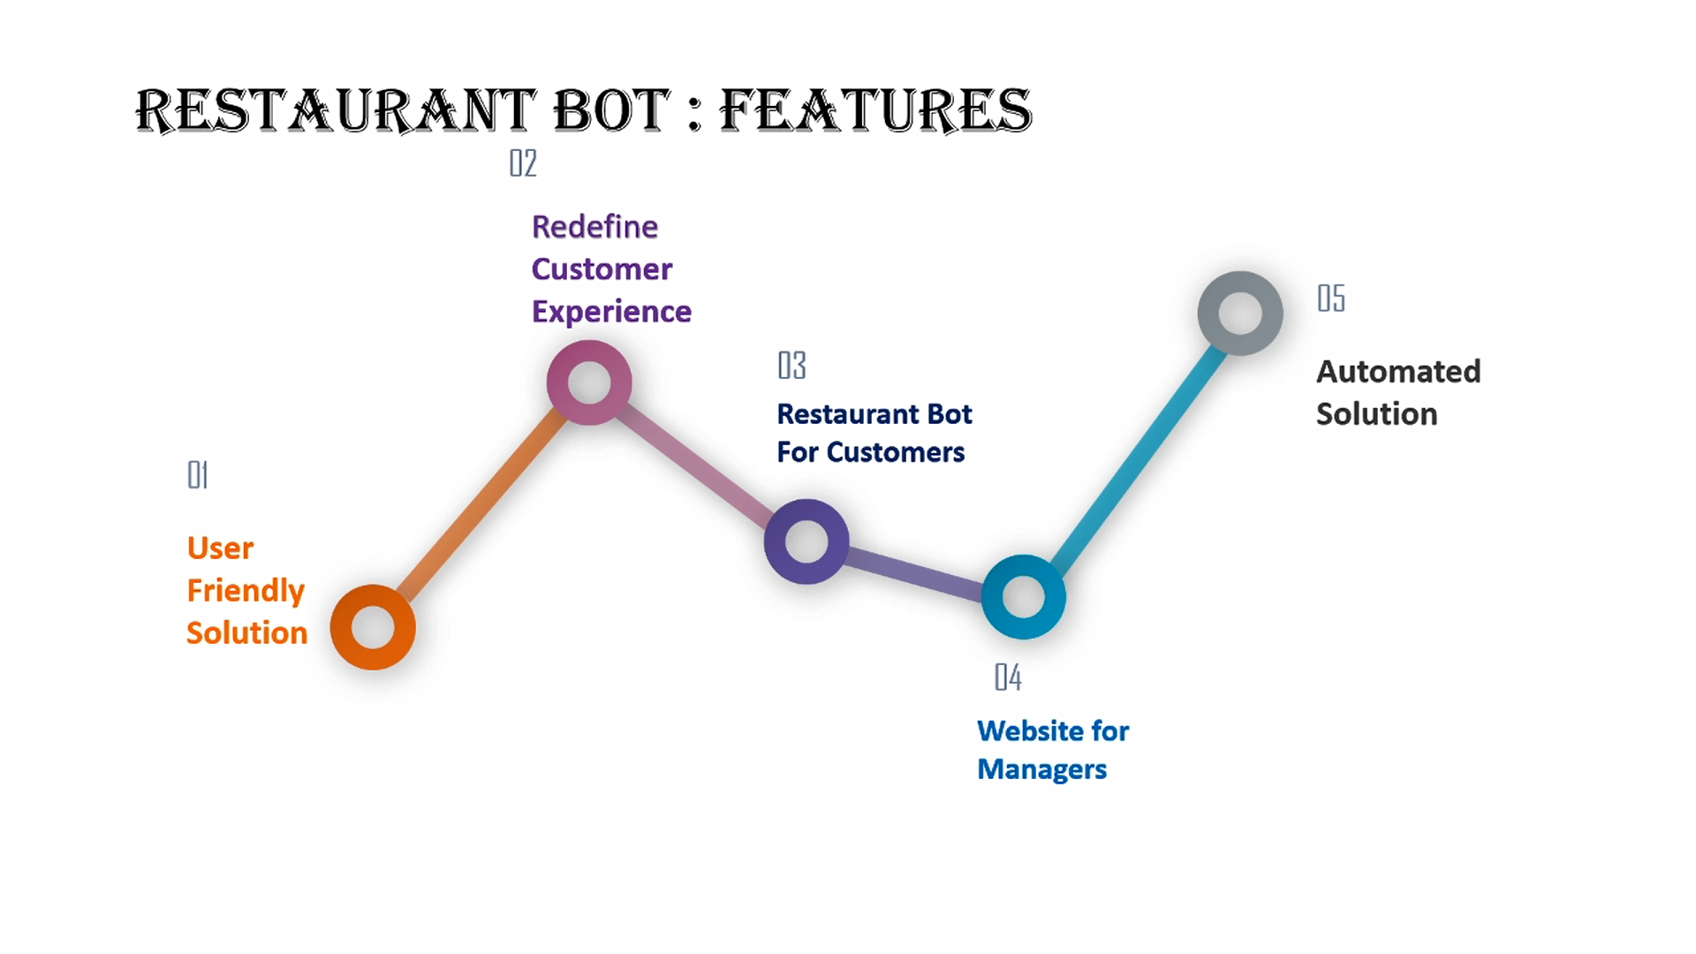

Slide 11
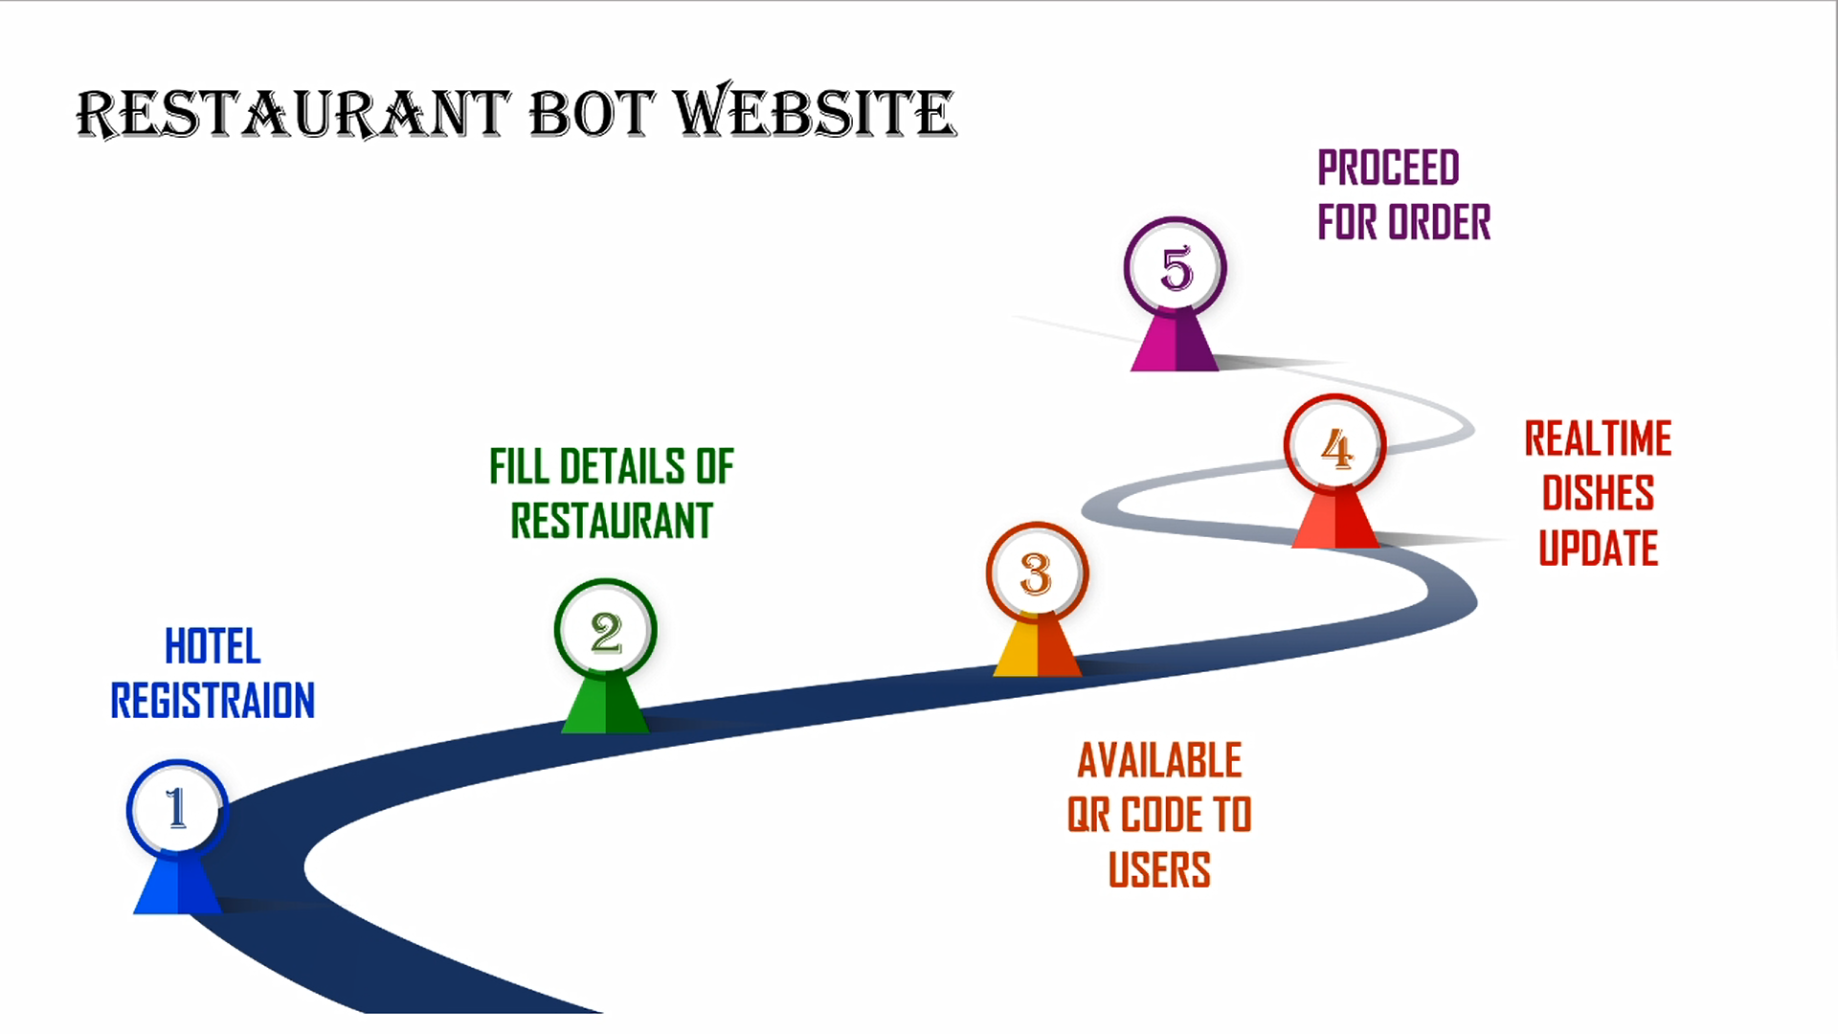

Slide 12
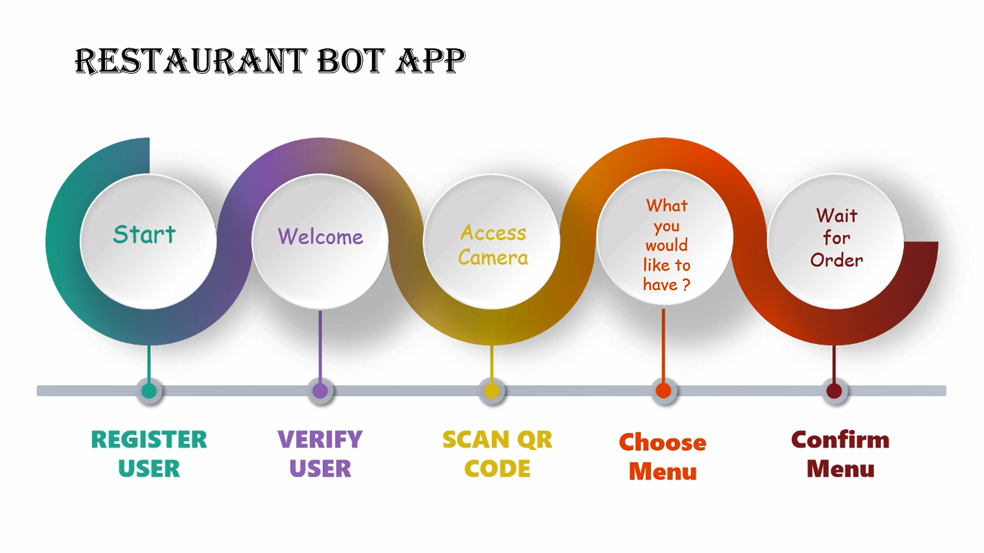

Slide 13
